Slide 1
Blood Bridge
Shreya Dhakal
Gambhir Shrestha
Reegzen Sangmo Thing

Slide 2

Introduction
Connects Nepal's blood donors with seekers.
Registers verified donor details online.
Filters searches by group and district.
Dispatches urgent blood requests instantly.
Built using HTML, CSS, JavaScript.
Operates fast, simple, and free.

Slide 3
Connect Donors
Organize Requests
Register willing donors.
Record blood groups.
Track donor districts.
Store contact details.
Enable quick searching.
.
Replace scattered social media posts.
Implement fast, organized search.
Create simple blood request system.
Accelerate emergency response times.

Slide 4
Problem Statement
Unorganized searching
Delayed responses
No central platform
Missing vital metrics

Slide 5
Features
Register Donor
Search Donor
Request Blood
Add your blood group, district and contact details in minutes.
Filter donors by blood group and district to find help fast.
Submit an urgent blood request - no account needed.

Slide 6
User Implementation
3. Search or Request
1. Sign Up
4. Connect & Donate
2. Register Donor
Find a donor or submit an urgent request.
Create an account and accept the terms.
Contact the donor directly and arrange donation.
Add your details, blood group and location.

Slide 7
Testing
Data Storage
Form Validation
Search & Filters
Responsive Design
Donors and requests are saved and reloaded from browser storage.
Name, email, contact and required fields are checked before saving.
Blood group and district filters return matching donors.
Pages work on mobile, tablet and desktop, with dark mode.

Slide 8
Limitations
No Backend - data is stored only in the browser's localStorage.
No Verification - donor eligibility and blood group are not verified.
Manual Contact - matching happens through the user's own phone call.

Slide 9
Future Improvements
Phase 1
Phase 2
Phase 3
Phase 4
Mobile app with push notifications
Real database and server backend
Donor verification and hospital integration
Nationwide expansion and analytics

Slide 10
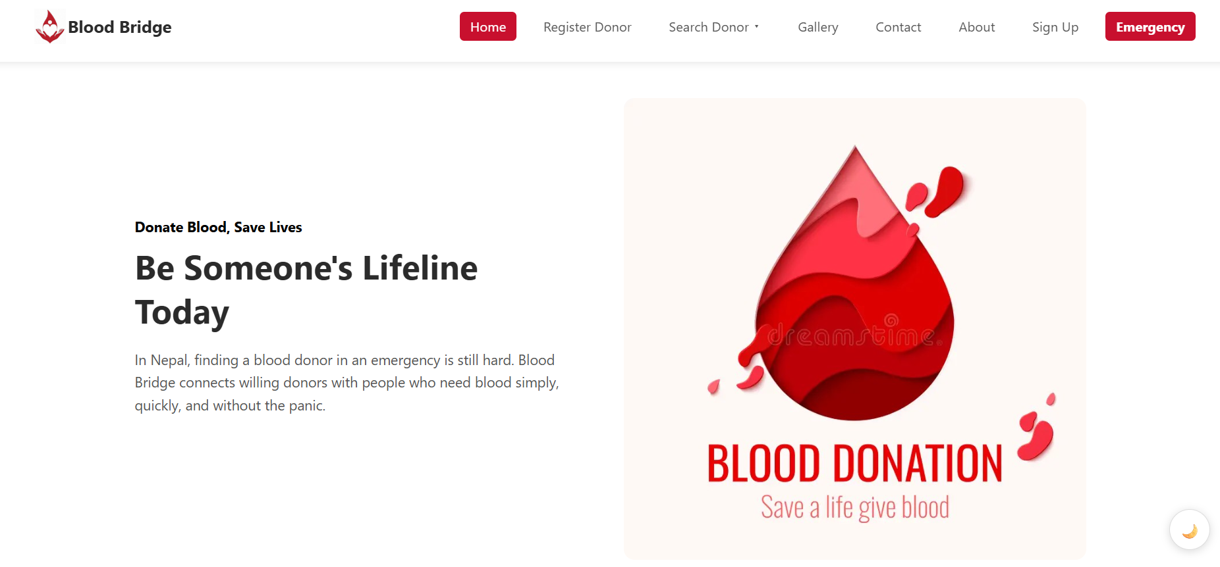
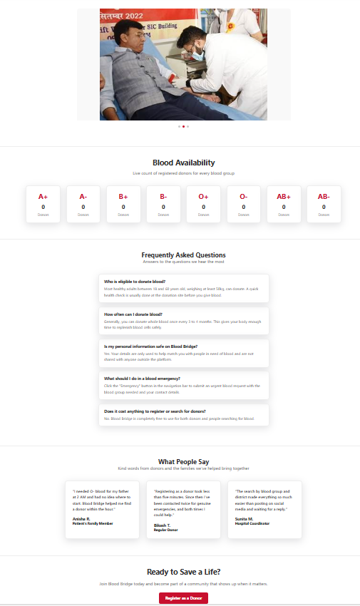
Preview of Blood Bridge

Slide 11
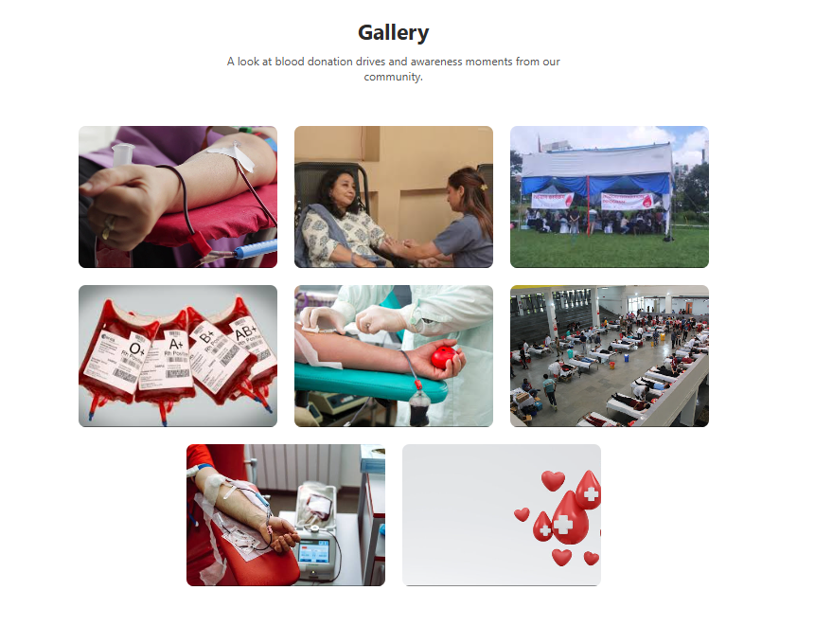
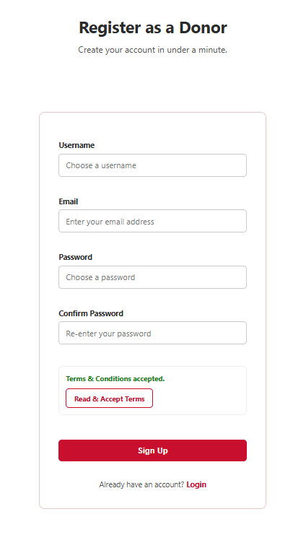
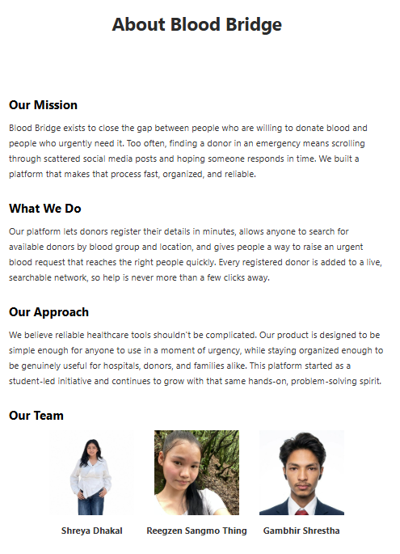
Preview of Blood Bridge

Slide 12
Conclusion
Any Questions

